Slide 1

Electrical engineering
Performed by: Barateliia Timur

Slide 2

1. Introduction A. Definition of Electrical Engineering B. Importance of Electrical Engineering

Slide 3

2. Brief History of Electrical Engineering

Slide 4
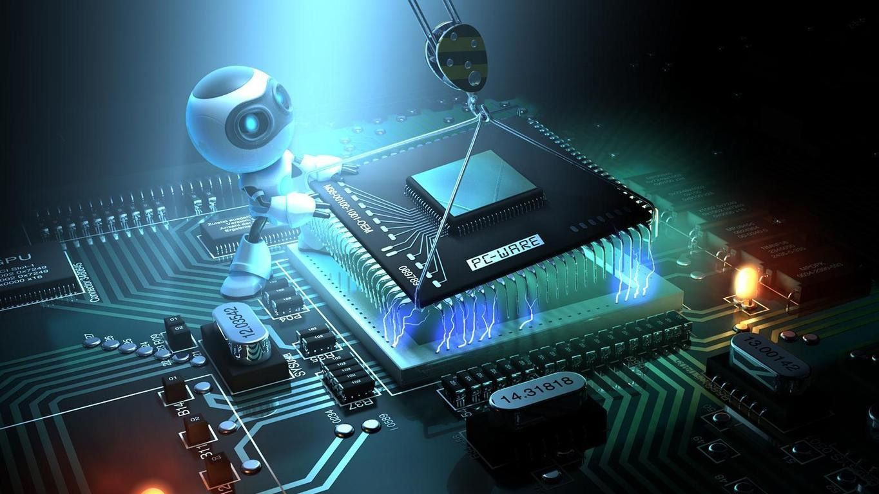
3. Scope of Electrical Engineering A. Branches of Electrical Engineering B. Applications of Electrical Engineering

Slide 5

4. Future of Electrical Engineering

Slide 6

5. Conclusion A. Summary of Electrical Engineering B. Future Possibilities in Electrical Engineering C. Importance of Electrical Engineering in Society

Slide 7


